Slide 1
TRIGGERING GUN WITH ALERT SYSTEM
TEAM MEMBERS
1.MADHUMITHA.B (113222072055)
2.ROHINI.V (113222072081)
3.SANGEETHA.S (113222072087)
GUIDED BY
DR.P.VISU
HEAD OF THE DEPARTMENT

Slide 2
ABSTRACT
Personal safety is a growing concern in today’s world, particularly for vulnerable individuals.
This paper presents an advanced safety device that integrates a stun gun mechanism with an emergency alert system.
The device is designed to be compact and portable, using a PVC pipe casing for ease of carrying.
When activated via a push button, the stun gun generates a high-voltage spark, temporarily disabling an attacker. Simultaneously, an emergency alert system comprising a SIM800L GSM module and NEO-6M GPS module sends the user’s realtime location to a predefined phone number.
The system also includes a sound sensor that can trigger the alert based on sound detection.
Powered by a 7.4V, 3200mAh battery, the device is energy-efficient and reliable.
This paper details the design, implementation, and testing of the proposed safety device.

Slide 3
LITERATURE REVIEW

Slide 4
“Design of Women Safety Device based on GPS”,Rupali Mahajan,International Research Journal of Engineering and Technology (IRJET),IEEE,HCST , Mathura, U.P., India,2021.
Switch is pressed by victim it generates a signal and this signal goes to our micro-controller board through which signal is sent to GSM module and GSM send current location to police and family members through the GPS .
And the another switch that we use in it is a Relay which is used for activating the stun-gun circuit.
Advantages
It sends emergency alerts via SMS to registered numbers, including nearby police stations. The device is small, making it easy to carry anywhere.
Limitations
Continuous GPS tracking and GSM usage may drain the battery quickly, limiting the operational time of the device. Accidental activation of the device could lead to unnecessary alerts and confusion.

Slide 5
“Design and Development of an Advanced Affordable Wearable Safety Device for Women:Freedom Against Fearsome”,Israt Humaira,Advances in Science,Technology and Engineering System Journals,2021.
This device resembles a normal jewelry like locket(BOHNNI) and bracelet(BADHON).
BOHNNI is locating device including a voice recognizer,Bluetooth,Arduino,GPS and gsm module.
Device is activated using voice password set by the user,it also has a buzzer that activates when it is touched.
Advantages
A wearable design ensures that the device is constantly on the user, providing continuous protection.
Designed to be comfortable and easily waerable, encouraging consistent use.
Limitations
The device’s performance may be affected by poor network or GPS signal availability, potentially reducing effectiveness in certain areas.
This device is physically dependent,if the attacker attacks the device it cannot send signals.

Slide 6
“Self Defence Device with GSM alert and GPS tracking with fingerprint verification for women safety”, Shaista Khanam,VCET, University of Mumbai, India,2019.
This device is designed like a portable baton,with GPS MODULE(sim 808),microcontroller(ARDUINO NANO),one optical sensor with finger print.
It works when the women keeps her fingerprint ,and it will produce spark upto 15 sec and send the alert msg to predefined mobile number.
Advantages
Combines self-defense and safety alert features, providing both offensive and defensive capabilities. Prevents unauthorized use, ensuring that only the registered user can activate the device.
Limitations
In stressful situations, the fingerprint sensor might fail to recognize the user quickly, delaying the activation.
If the device is stolen or lost, there is a risk of it being misused, although fingerprint protection mitigates this.

Slide 7
“Design of a Smart Safety Device for Women using IoT”,Wasim Akram,International Conference of Recent Trends in Advanced Computing,2019.
It is a mobile app designed with the help GSM and GPS module and it is consist of both hardware and software device ,basically it is a app ,this device is activated with the help of finger print verification.
Once the person keep the finger print the circuit will activate and produce the current and the live location to the family members and police,with the help of the app the person can reach home safely from her current location.
Advantages
Provides a quick and reliable way to alert emergency contacts or services, potentially reducing response times in critical situations.
The device can be easily worn as a wristband, necklace, or another form, making it convenient for everyday use.
Limitations
Continuous GPS tracking might raise privacy concerns, as it involves constant monitoring of the wearer’s location.
The integration of advanced technologies can make the device relatively expensive, potentially limiting accessibility for some users.

Slide 8
“The Personal Stun- A Smart Device For Women’s Safety”,Shivani Ahir,Universal College of Engineering ,Kaman, Mumbai,India,2018.
The device consists of a piezo buzzer that emits beep sound after 1 minute of actual activation of the device. The range of the buzzer covers up to 50 meters of radius. If the suspect tries to remove the band and throw it, the force sensors will start working and buzzer will start ringing and the location at that particular time will be sent.
On the top of the band there are two nodes which will emit electric current as soon as it comes in contact with any surface after the device is activated. The current is generated with the help of leakage current. The device and the smart phone are connected using Bluetooth, which is responsible for the overall data sharing and connectivity.
Advantages
The device can be easily activated by tapping on the screen twice, making it fast and accessible in emergencies. The buzzer emits a sound between 80-110 dB, loud enough to attract attention and deter attackers.
Limitations
The device could be accidentally activated if the screen is tapped twice unintentionally, which might cause unnecessary alerts.
The buzzer has a limited range (50 feet), so in a noisy environment or over a larger distance, it might not be effective in alerting others.

Slide 9
PROPOSED SYSTEM
The proposed system is a smart personal security device integrating self-defense and emergency alert functionalities. It consists of three key modules:
Stun Gun Module – Generates a high-voltage electric spark upon activation to temporarily incapacitate attackers. It is housed in a portable 26mm PVC pipe and powered by a 26.7V, 3200mAh battery.
Emergency Alert & Location Sharing Module – Uses an Arduino ATmega328P to process inputs, a NEO6M GPS module for real-time location tracking, and a SIM8001 GSM module to send emergency alerts with live coordinates. It can be activated via a push button, a sound sensor detecting distress noises, or an integrated buzzer alarm.
Power Management System – Ensures stable operation with a TP4056 battery charger and an LM2586 DC-DC converter to regulate voltage.
This device activates by two ways like buzzer detection or sound detection recognition .
After this authentication the location and alert messages will be sent to the authorized contact numbers using SIM-900C (GSM-GPS Module).
By using the stungun switch the shock will be produced for producing the current.

Slide 10
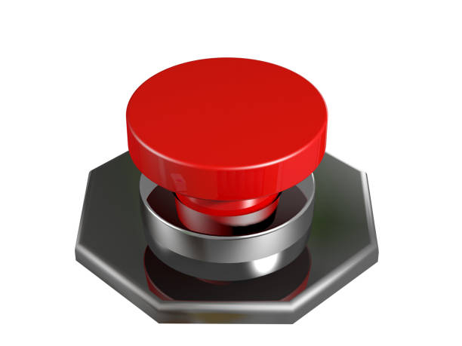





Architecture Diagram
Buzzer
Buzzer
Yes
Yes
No
No
GSM &GPS Module Activated
Device Off
Electric Shock Generated
Pre-Defined Number
Alert Message & Location

Slide 11
LIST OF MODULES
This project consist of totally 3 modules:
Module 1 – Stun Gun Model.
Module 2 – Power management System.
Module 3– Emergency Alert and Location Sharing System.
Module 4 or Final output – integration of both Hardware and Software.

Slide 12
MODULE 1
Stun Gun Module:
This module is responsible for the self-defense mechanism of the Triggering Gun
with AlertSystem.
It delivers an immediate electric shock to temporarily disable an attacker, giving the
user time to escape.
Key Features:
High-Voltage Shock: Generates an electric discharge using a step-up transformer.
Push-Button Activation: Users can activate the stun gun manually when facing an immediate threat.
Compact Design: Encased in a 34mm PVC pipe for easy handling and portability.
Power Supply: Uses a 26.7V, 3200mAh lithium battery to ensure long-lasting operation.
Safety Measures: The voltage level is controlled to prevent fatal injuries while effectively neutralizing the attacker.
Working Mechanism:
When the push button is pressed, the stun gun circuit is activated.
A high-voltage spark is generated to incapacitate the attacker momentarily.
The power supply is regulated to ensure consistent performance and prevent circuit failures.
The stun gun remains portable and lightweight, making it easy to carry for personal safety.

Slide 13
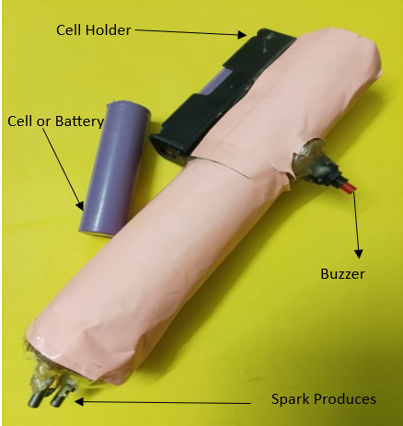
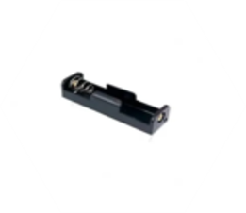
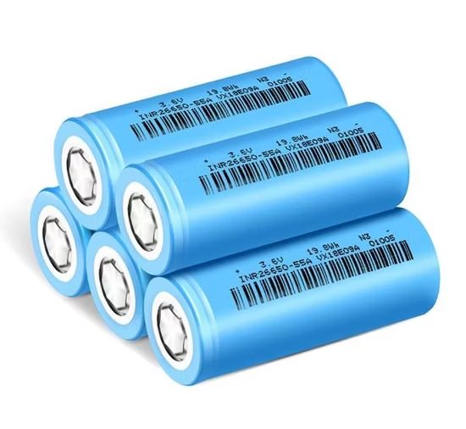
MODULE 1 OUTPUT
Components used
Output

Slide 14
MODULE 2
Power Management System & Code Implementation
This module ensures stable power distribution to the stun gun, GPS, GSM, and
other components, improving efficiency and battery life.
Key Components:
Battery (7.4V, 3200mAh Lithium Battery) – Provides power to all modules.
TP4056 Charging Module – Ensures safe and controlled charging to prevent overcharging.
LM2586 DC-DC Converter – Regulates voltage supply for stable performance.
Power Optimization Strategies:
Low-Power Design: Optimized coding to reduce unnecessary power consumption.
Energy-Efficient Components: Ensures prolonged usage on a single charge.
Safe Charging Mechanism: Prevents overheating and circuit damage during charging cycles.

Slide 15
MODULE 2 OUTPUT
Power Management & Software code is implemented
#include<SoftwareSerial.h> #include <TinyGPS.h> float lat = 13.0827, lon = 80.2707; // create variable for latitude and longitude object SoftwareSerial gpsSerial(6, 5);//rx,tx TinyGPS gps; // create gps object String latitude; String longitude; #define pushbutton 2 #define buzzer 13 int SoundSensor1 = 12; int SoundState1; void message1(void); void message2(void); void setup() { Serial.begin(9600); gpsSerial.begin(9600); pinMode(pushbutton, INPUT_PULLUP); pinMode(SoundSensor1, INPUT); pinMode(buzzer, OUTPUT); digitalWrite(buzzer, LOW); } void loop() { if((digitalRead(pushbutton) == LOW) || (digitalRead(SoundSensor1) == 0))
{ latitude = 13.0827; longitude = 80.2707; Serial.println("Safety Alert"); digitalWrite(buzzer, HIGH); delay(100); message1(); Serial.println("Safety Alert Message 1 Sent"); delay(100); delay(100); message2(); Serial.println("Safety Alert Message 2 Sent"); delay(100); digitalWrite(buzzer, LOW); Serial.println(" ");
while(gpsSerial.available()) { // check for gps data if(gps.encode(gpsSerial.read()))// encode gps data { gps.f_get_position(&lat,&lon); // get latitude and longitude Serial.print("Position: "); Serial.print("Latitude:"); Serial.print(lat,6); Serial.print(";"); Serial.print("Longitude:"); Serial.println(lon,6); String latitude = String(lat,6); String longitude = String(lon,6); Serial.println(latitude+";"+longitude); delay(500); } }
Serial.println("******************************************************"); Serial.println(" "); delay(5000); // Interval 30 seconds = 30*1000 // Interval 60 sec = 60*1000 } } void message1(void) { Serial.print("AT\r\n");delay(800); Serial.print("AT+CMGF=1\r\n");delay(800); Serial.print("AT+CMGS=");delay(500); Serial.write('"');delay(500); Serial.print("9940033064");delay(500);//Change the calling number Serial.write('"'); Serial.print("\r\n");delay(500); Serial.print("'Safety Alert'\r\n http://maps.google.com/maps?q=loc:"+latitude+","+longitude);delay(500);//17 delay(500); Serial.write((char)26); } void message2(void) { Serial.print("AT\r\n");delay(800); Serial.print("AT+CMGF=1\r\n");delay(800); Serial.print("AT+CMGS=");delay(500); Serial.write('"');delay(500); Serial.print("9952243782");delay(500);//Change the calling number Serial.write('"'); Serial.print("\r\n");delay(500); Serial.print("'Safety Alert'\r\n http://maps.google.com/maps?q=loc:"+latitude+","+longitude);delay(500);//17 delay(500); Serial.write((char)26); }

Slide 16
MODULE 3
Emergency Alert & Location Sharing Module
This module ensures real-time distress communication by sending emergency alerts
To predefined contacts.
Key Components:
GPS (NEO-6M) – Captures real-time location data.
GSM (SIM800L) – Sends emergency SMS with live coordinates.
Microcontroller (ATmega328P) – Controls and processes data.
Sound Sensor (KY-038) – Detects distress sounds (like screams) and triggers alerts automatically.
Buzzer – Produces a loud alarm to attract attention.
Working Mechanism:
Manual Activation: User presses the emergency button to trigger an alert.
Automatic Activation: The sound sensor detects loud distress noises and triggers the alert.
Location Tracking: The GPS module captures real-time coordinates.
Emergency Alert Transmission: The GSM module sends an SMS containing the user’s live location to predefined contacts.
Buzzer Activation: A loud alarm is emitted to draw attention and seek immediate help.

Slide 17
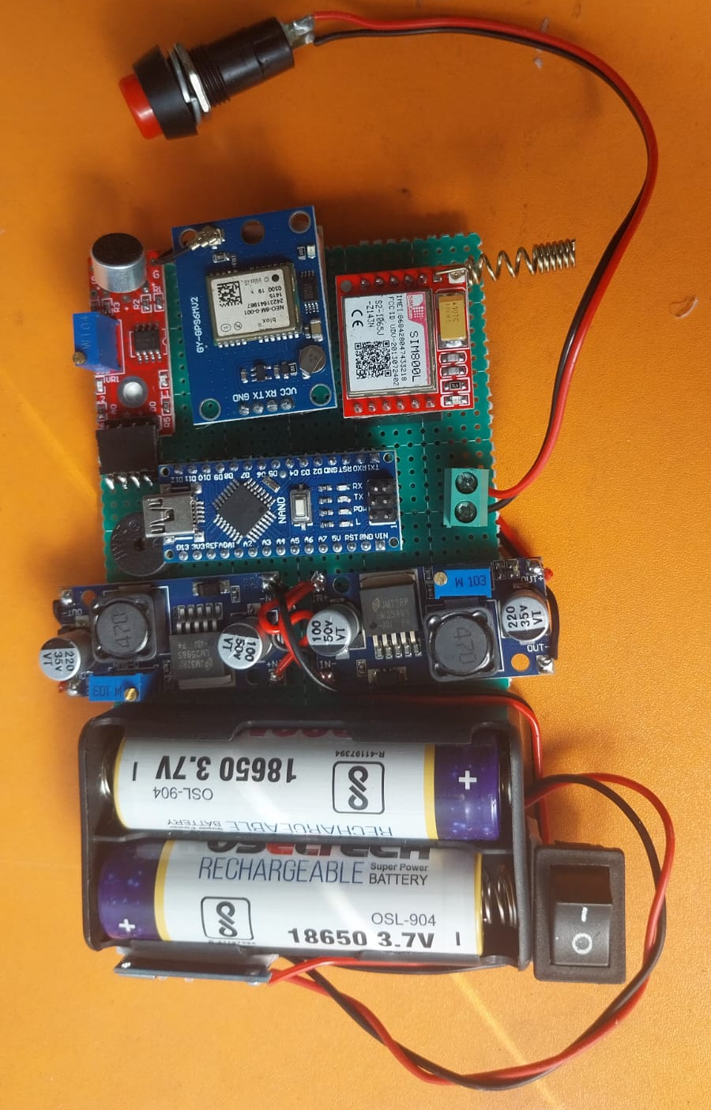
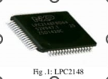





MODULE 3 OUTPUT
Few components listed
ARM Micro
controller
Push Button
GSM
GPS
BUZZER
RELAY

Slide 18
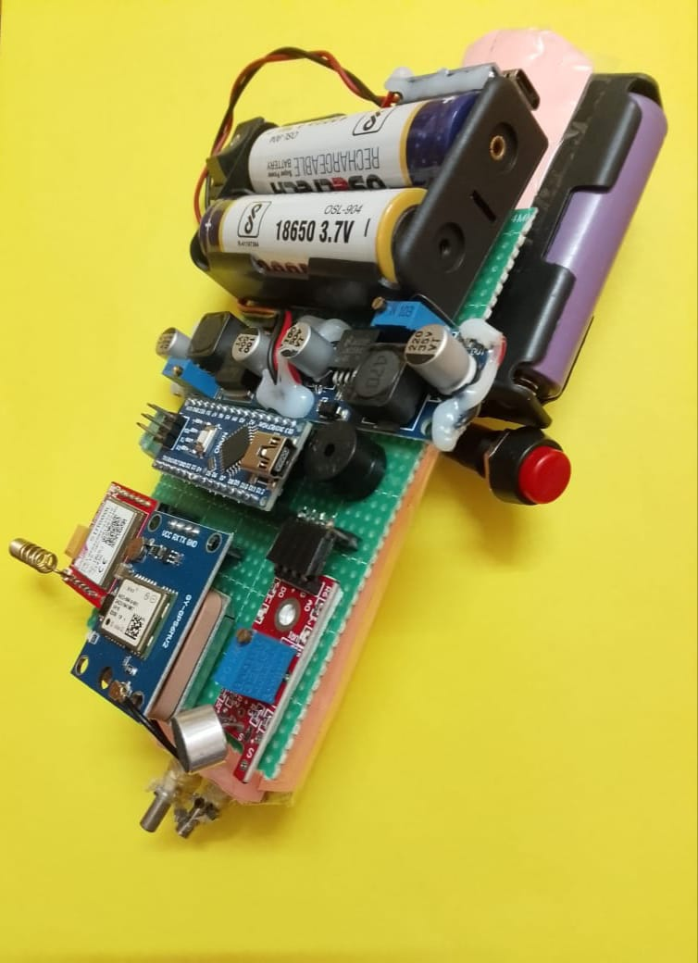
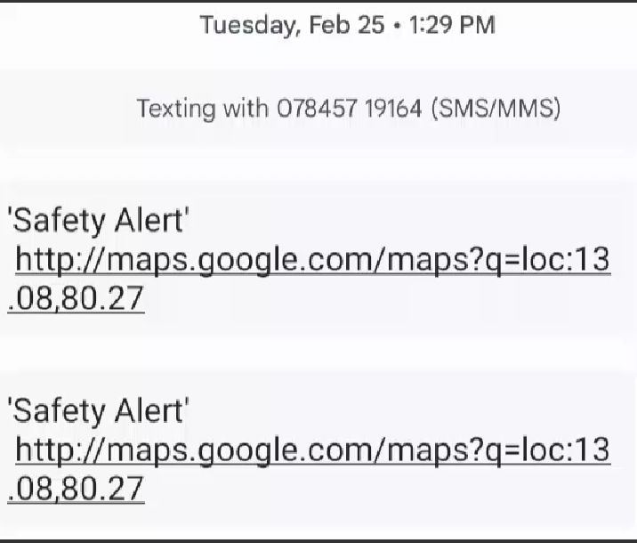
FINAL OUTPUT
The final output is, shock will be produced and alert msg will be send to pre-defined by buzzer or sound detection

Slide 19
THANK YOU

